Slide 1
Report on
Business Analytics Capstone Project
(Using R)
Domain – Real Estate
Project ID : CP1
Satish Rawat

Slide 2

BUSINESS ANALYTICS CAPSTONE PROJECT REPORT
Boston Housing Value Prediction
1. AN INTRODUCTION

Slide 3
BUSINESS ANALYTICS CAPSTONE PROJECT REPORT
1.1 Project Brief
In this project, we will evaluate the performance and predictive power of a model that has been trained on data collected from homes in suburbs of Boston, Massachusetts. A model trained on this data that is seen as a good fit could then be used to make certain predictions about a home — in particular, its monetary value. This model would prove to be invaluable for City Council of Boston, Massachusetts who could make use of such information on a daily basis.

Slide 4
BUSINESS ANALYTICS CAPSTONE PROJECT REPORT
1.2 Objective of the Study
Finding Key Drivers for improving values of homes in Boston.
Find Trends and Pattern in Dataset to help city council to take better decisions.
Making a Predictive Model to predict values of homes.

Slide 5
BUSINESS ANALYTICS CAPSTONE PROJECT REPORT
1.3 Approach of the Study :- Brief Introduction of Approach
Load Dataset.
Transform Dataset.
Check for missing values and outliers.
Treat missing values and outliers.
Data Exploration and Data visualisation.
Make a predictive model using relevant statistical modelling technique.
Evaluate and validate model on certain metrics and improve model.

Slide 6
BUSINESS ANALYTICS CAPSTONE PROJECT REPORT
BASIC INTRODUCTION TO METHOD
This Dataset contains 14 columns and 506 rows.
For making predictive model for Boston, we will be using statistical known as Linear Regression.
A linear regression model can be used to identify the relationship between independent variables and the dependent variable.
Linear regression model is improved by various method like dropping weaker independent variables in iterative way.
Linear regression model evaluated on various metrics like R2, adjusted R2, MAE and much more.
For model evaluation and validation we are going to use Bootstrap and 5 Fold repeated Cross Validation sampling method and select the best model based on lower MAE.

Slide 7
BUSINESS ANALYTICS CAPSTONE PROJECT REPORT
1.4 Scope and Limitation of the Study
Scope
This project helps us to identify key parameters that is affecting the values of homes in Boston.
This project helps us to predict prices of homes in Boston on certain parameters.
Limitations
This project is only applicable to Boston city because dataset contains data related to Boston city.
The model in this project can only predict value of homes on certain parameters using Linear Regression.

Slide 8

BUSINESS ANALYTICS CAPSTONE PROJECT REPORT
2. DATA EXPLORATION AND VISUALISATION

Slide 9
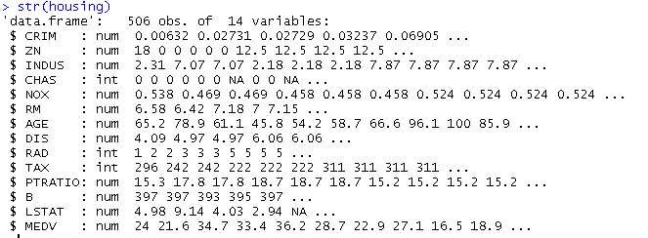
BUSINESS ANALYTICS CAPSTONE PROJECT REPORT
DATA EXPLORATION :- Descriptive Analysis
This Dataset Contains 506 Observations and 14 variables.

Slide 10
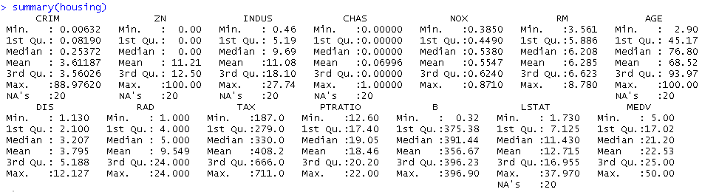
BUSINESS ANALYTICS CAPSTONE PROJECT REPORT
DATA EXPLORATION :- Descriptive Analysis
Summary report of Dataset.
Values are missing in the column CRIM, ZN, INDUS, AGE, LSTAT.

Slide 11
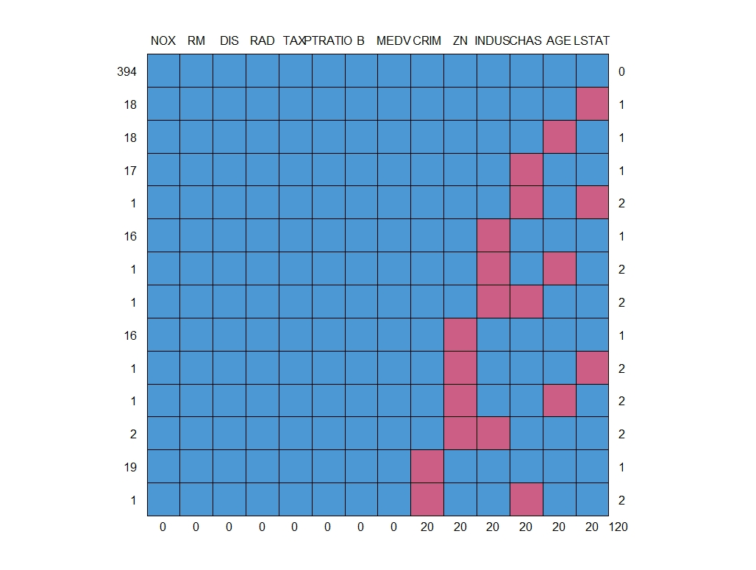
BUSINESS ANALYTICS CAPSTONE PROJECT REPORT
DATA VISUALISATION :- Missing Values
Missing Values Plot Using Mice Package
Right side label :- number of missing values
Top side label :- Column name
Left side label :- 0 for observed values, 1 for missing values
Bottom label :- Total missing values in respective column

Slide 12
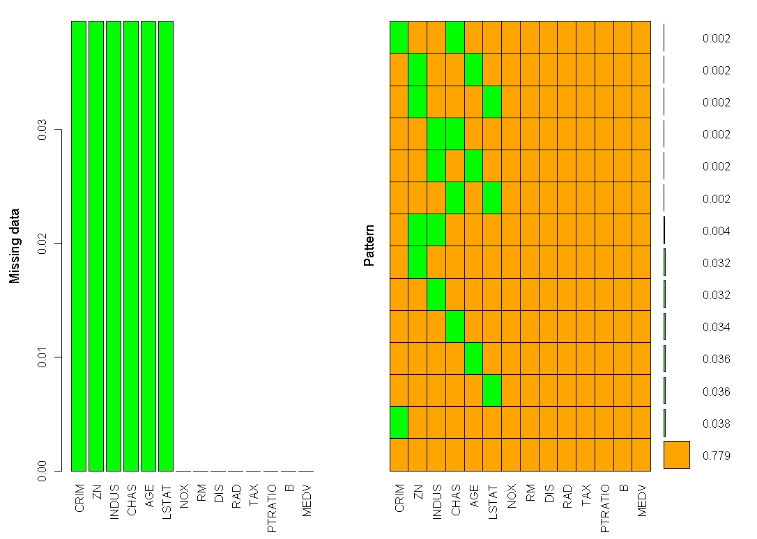
BUSINESS ANALYTICS CAPSTONE PROJECT REPORT
DATA VISUALISATION
Missing Value Plot
Let’s quickly understand this. There are 78% values in the data set with no missing value. There are 3.6% missing values in CRIM, 3.6% missing values in LSTAT and so on.

Slide 13
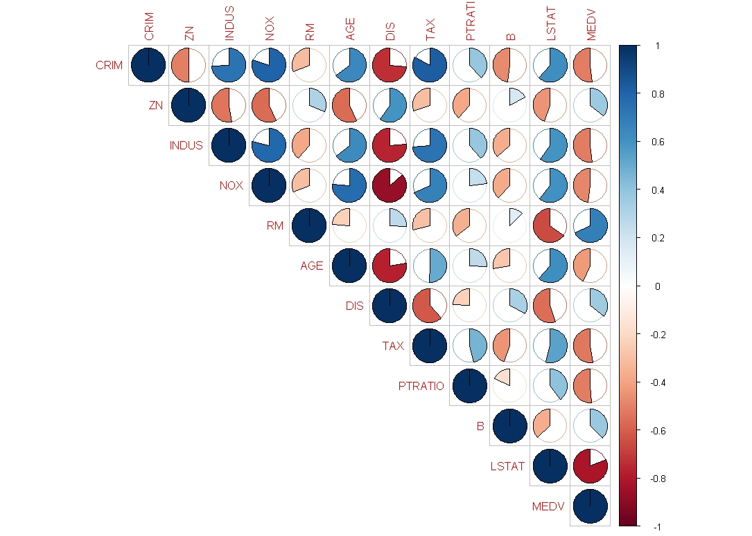
BUSINESS ANALYTICS CAPSTONE PROJECT REPORT
DATA VISUALISATION :- Correlation Plot
Correlation Plot
Let’s quickly understand this plot shaded area shows magnitude of relationship, whereas color shows the direction of relationship(Positive or Negative).
For good model, there should be strong relationship between independent variable and independent variable and no or weak relationship between independent variables

Slide 14
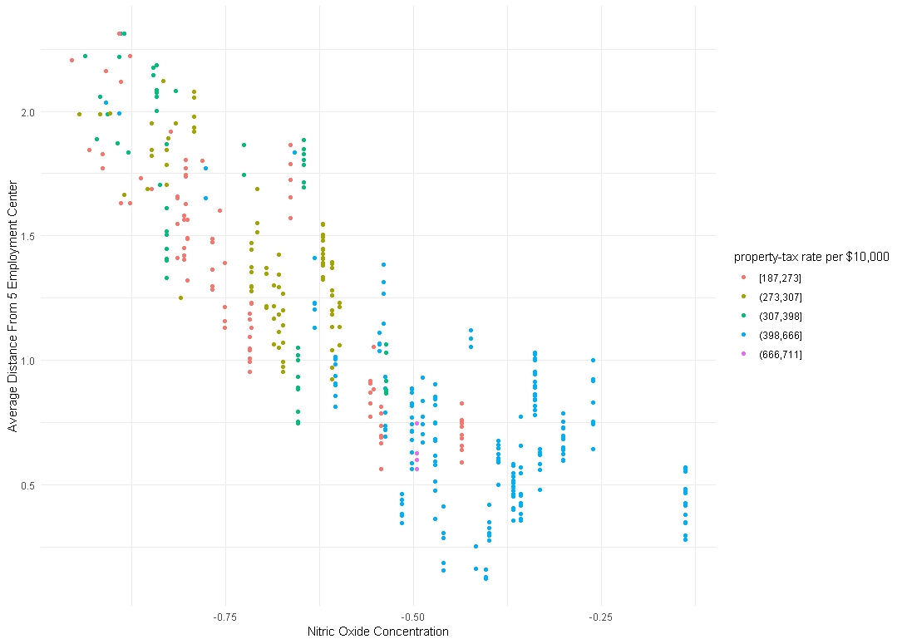
BUSINESS ANALYTICS CAPSTONE PROJECT REPORT
DATA VISUALISATION
Most homes are in a area where Nitric Oxide Concentration are low and average distance from 5 employment centre is in range 0 to 1.5.

Slide 15
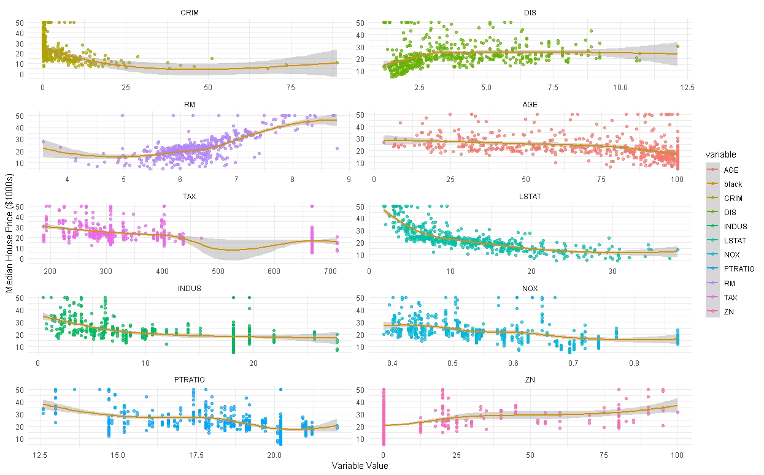
BUSINESS ANALYTICS CAPSTONE PROJECT REPORT
DATA VISUALISATION :- Scatter Plot
Scatter Plot Between numeric independent variables and dependent variable(MEDV)

Slide 16
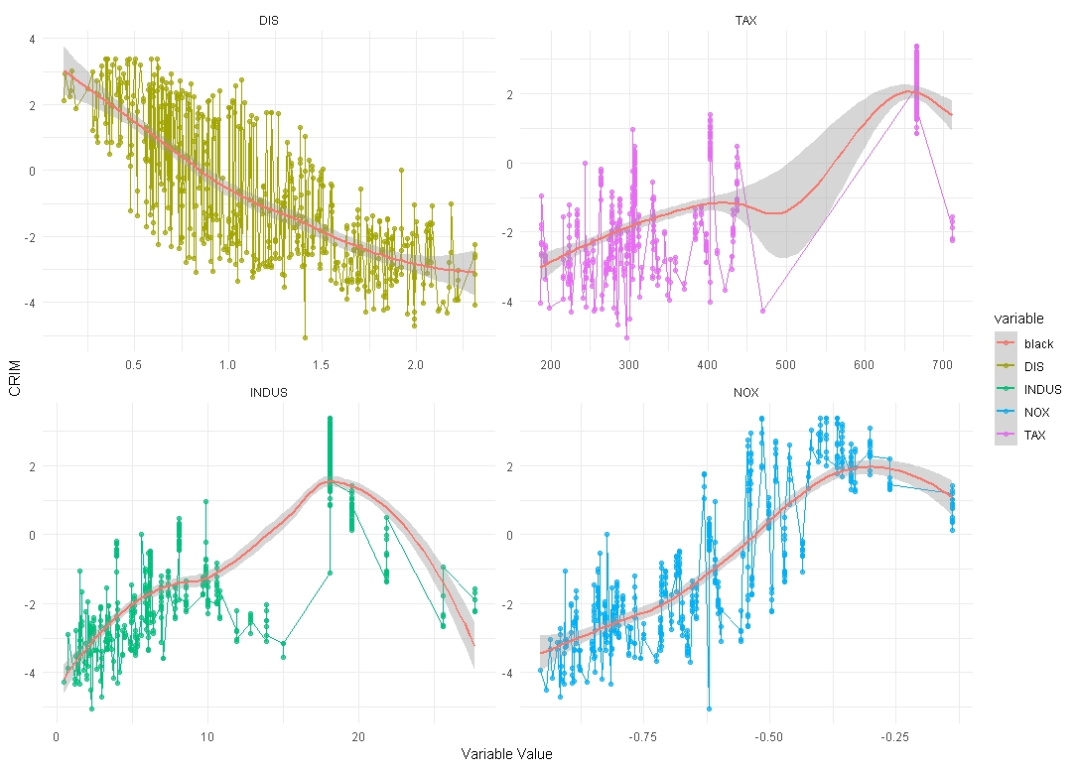
BUSINESS ANALYTICS CAPSTONE PROJECT REPORT
DATA VISUALISATION
Crime rate increases with increase in Nitric Oxide Concentration and decrease with increase in DIS.
This implies that crime rate is high in city nearby industrial area or where population density is high.

Slide 17
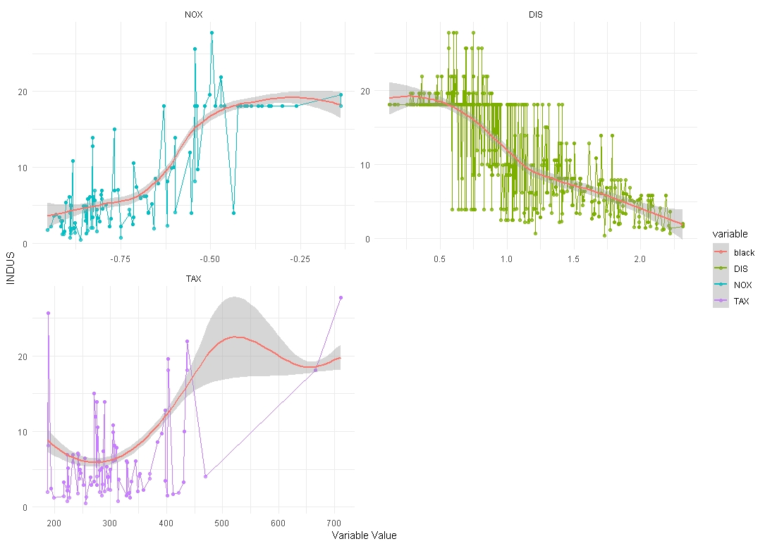
BUSINESS ANALYTICS CAPSTONE PROJECT REPORT
DATA VISUALISATION
INDUS decreases with increase in DIS.
This implies that with increase in distance from employment centre there is decrease in non retail business.

Slide 18
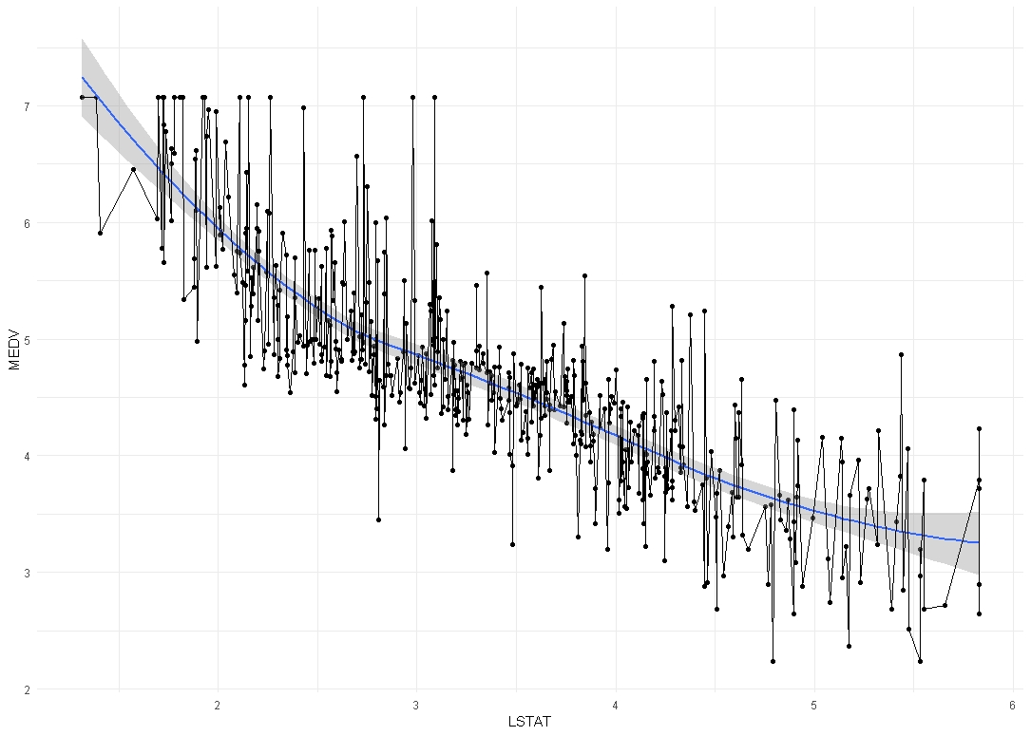
BUSINESS ANALYTICS CAPSTONE PROJECT REPORT
DATA VISUALISATION
MEDV decreases with increase in LSTAT.
This implies that values of homes are low where percentage of lower status people is high.

Slide 19

BUSINESS ANALYTICS CAPSTONE PROJECT REPORT
3. DATA PREPARATION

Slide 20
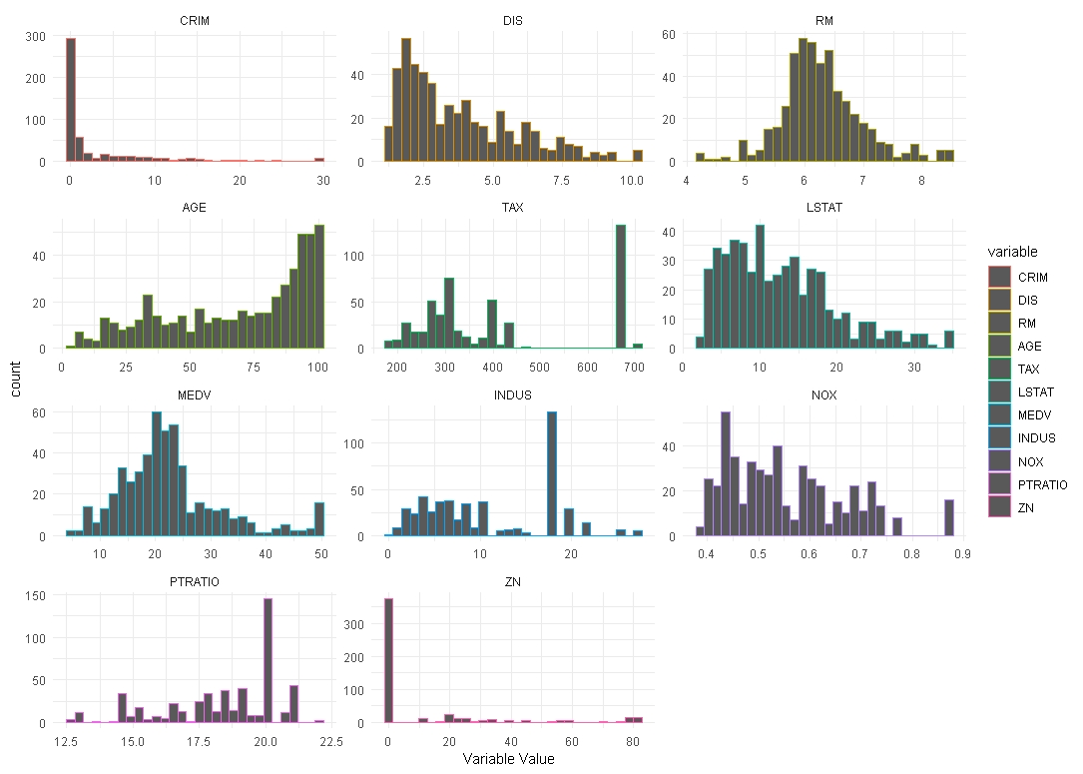
BUSINESS ANALYTICS CAPSTONE PROJECT REPORT
DATA TRANSFORMATION
Plotting Histogram to see the distribution of variables as some variables are not normally distributed.

Slide 21
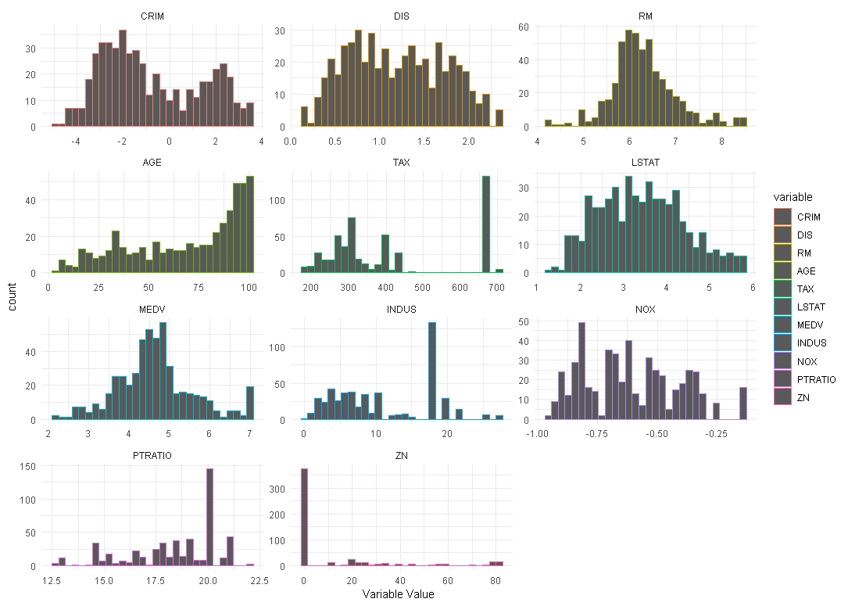
BUSINESS ANALYTICS CAPSTONE PROJECT REPORT
DATA TRANSFORMATION
Plotting Histogram to see the distribution of variables after applying relative transformation.
Applied log transformation on CRIM,NOX,DIS and square root transformation on LSTAT,MEDV.

Slide 22

BUSINESS ANALYTICS CAPSTONE PROJECT REPORT
4. DATA MODELLING

Slide 23
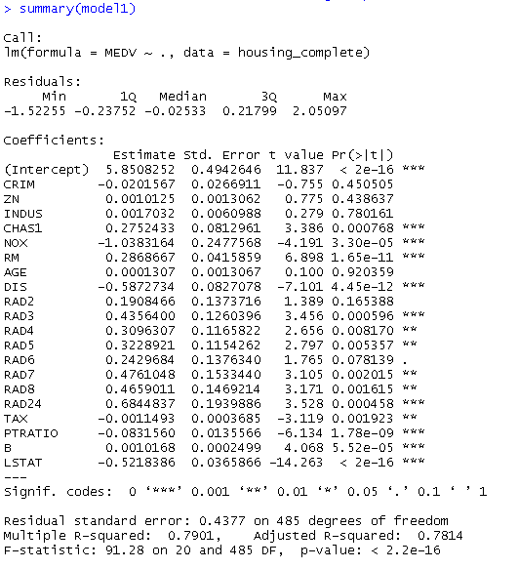
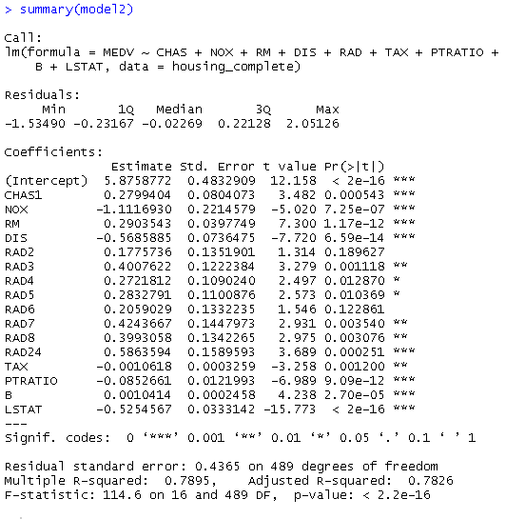
BUSINESS ANALYTICS CAPSTONE PROJECT REPORT
PREDICTIVE MODEL USING LINEAR REGRESSION
Model1 has all the variables and model2 has only 10 variables and removed variables are INDUS,CRIM,ZN and AGE.
Model1 has insignificant variables such as CRIM,ZN and etc. Whereas in Model2 all the variables are important as we can observe from summary using significance code.

Slide 24
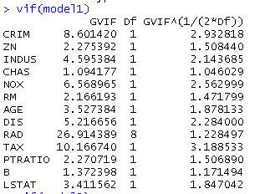
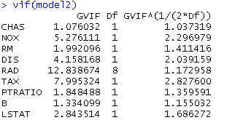
BUSINESS ANALYTICS CAPSTONE PROJECT REPORT
PREDICTIVE MODEL USING LINEAR REGRESSION
Comparing variation inflation factor of Model1 and Model2.
In both model there are variables which are more than 5, so both models are not good.

Slide 25
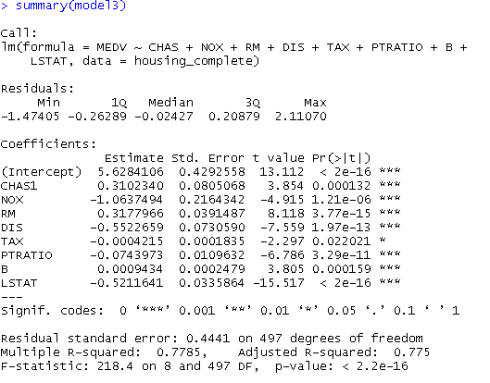
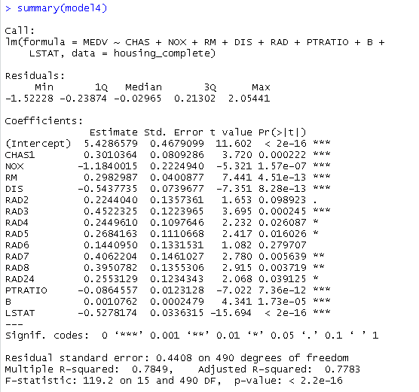
BUSINESS ANALYTICS CAPSTONE PROJECT REPORT
PREDICTIVE MODEL USING LINEAR REGRESSION
Model3 is obtained from Model2 by removing RAD and Model4 is obtained from Model2 by removing TAX.
Model3 variables has P-Value less than 0.05 which is good. Whereas in Model4 some variables has P-Value greater than 0.05.

Slide 26
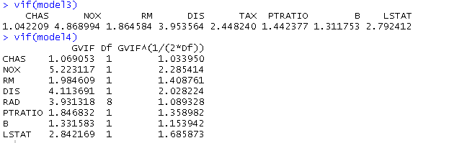
BUSINESS ANALYTICS CAPSTONE PROJECT REPORT
PREDICTIVE MODEL USING LINEAR REGRESSION
Comparing variation inflation factor of Model3 and Model4.
Both Models have VIF less than 5, but after observing closely NOX variables it is seen that in Model3 its value is less than 5 and in Model4 it is slightly greater than 5.

Slide 27
BUSINESS ANALYTICS CAPSTONE PROJECT REPORT
PREDICTIVE MODEL USING LINEAR REGRESSION
Mean Absolute Error(MAE) :- The mean absolute error is an average of the absolute errors.
Lower MAE means model is more accurate.
For Bootstrapping sampling method Model3 has lowest MAE
For 5 Fold Repeated Cross Validation Model2 has lowest MAE
Model Evaluation Metric
 | Bootstrap | 5 Fold RCV
Model1 | 0.3349107 | 0.33027
Model2 | 0.328595 | 0.3232398
Model3 | 0.3272363 | 0.3244256
Model4 | 0.3307824 | 0.3263791

Slide 28
BUSINESS ANALYTICS CAPSTONE PROJECT REPORT
PREDICTIVE MODEL USING LINEAR REGRESSION
Final Predictive Model is Model3 due to following reasons :-
VIF of all variables is less than 5.
P-Value of all variables is less than 0.05.
F-Statistic is highest of all 4 Models.
All T-Values are far from 0.
Least difference between R Square and Adjusted R Square.
Lowest MAE in 5 Fold Repeated Cross Validation.

Slide 29

BUSINESS ANALYTICS CAPSTONE PROJECT REPORT
5. INSIGHTS DERIVED AND RECOMMENDATIONS

Slide 30
BUSINESS ANALYTICS CAPSTONE PROJECT REPORT
INSIGHTS AND RECOMMENDATION
Insights
Crime Rates are high in city where Nitric Oxide Concentration are high.
Value of homes are low where Pupil Teacher Ratio is high.
Crime Rates are high where Tax are high in the city.
Where Tax are high Nitric Concentration are also high.
Index 4,5 and 24 of accessibility to radial highways have highest number of homes.
Value of home are low where percentage of lower status people are high.
Nitric Oxide Concentration, Average distance from 5 employment center are important factor which effects the value of homes in Boston.
Maximum Tax comes from where full value of property is in range of $39,80,000 to $66,60,000.
Maximum consumers are in the area where Nitric Oxide Concentration is low and Average distance from 5 employment center is in range of 0 to 1.5.
Recommendation
Increase security workforce near Industrial Areas and Posh Area.
Maintain Pupil teacher ratio by monitoring the number of Educations property in an area.
Spread employment centre across city so that Nitric Oxide Concentration can be maintain, Values of home can be increased.

Slide 31
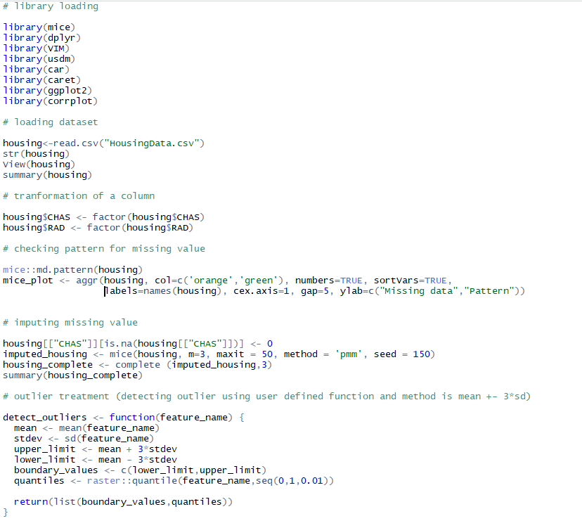
I. COMPILATION OF R CODE

Slide 32
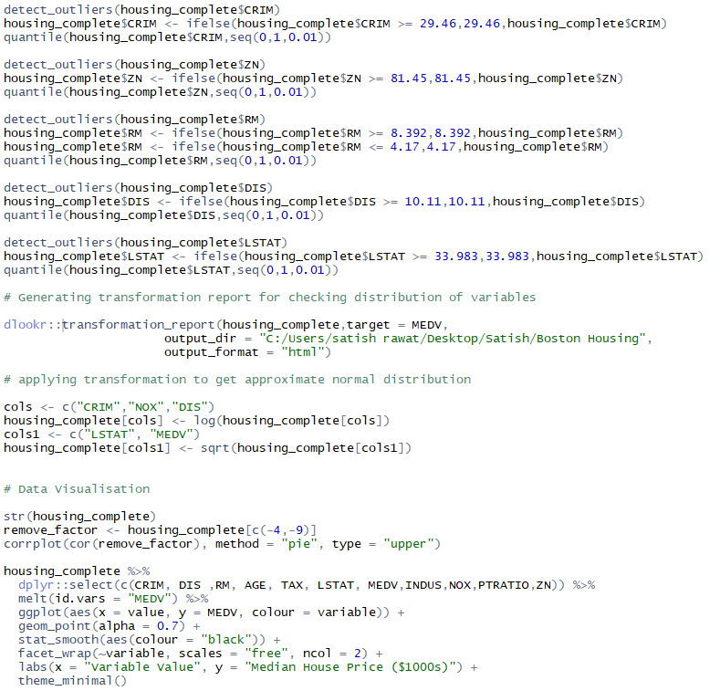
I. COMPILATION OF R CODE

Slide 33
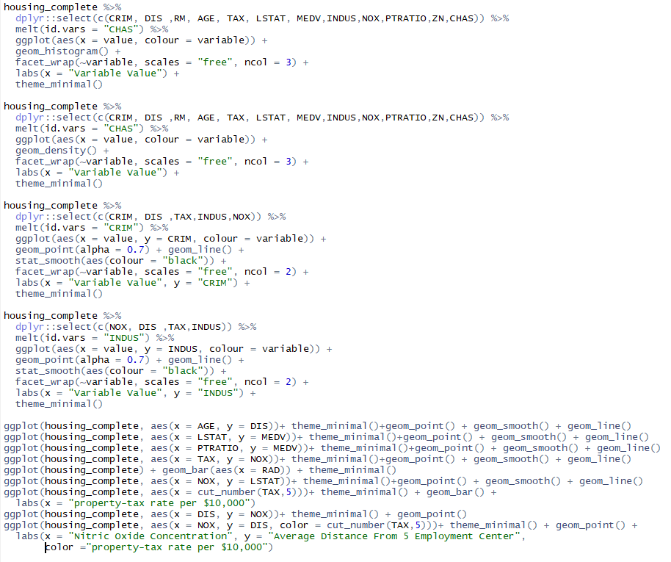
I. COMPILATION OF R CODE

Slide 34
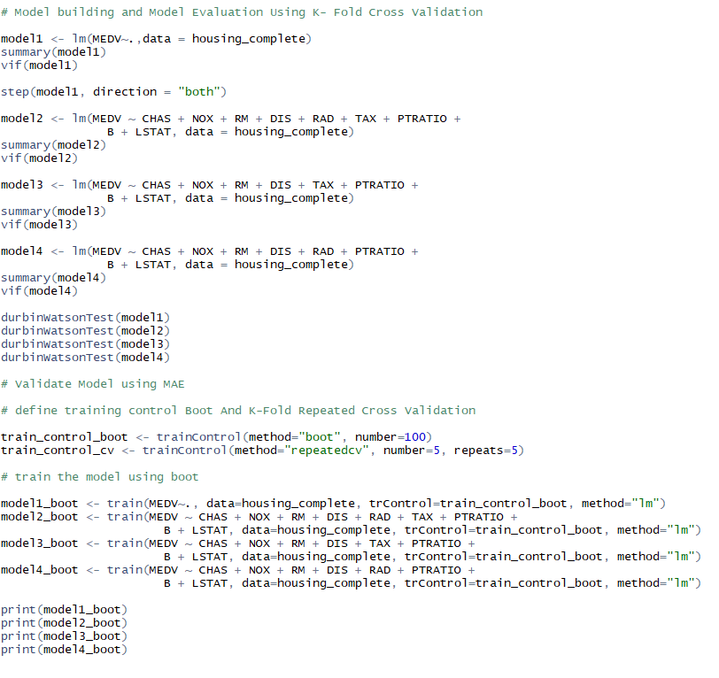
I. COMPILATION OF R CODE

Slide 35
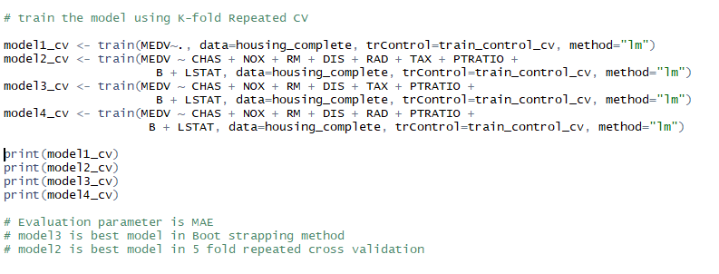
I. COMPILATION OF R CODE

